Slide 1
SSO in LMDz, « en route » toward DYNAMICO
Runs presented :
SSO variables calculated using
1) Spherical harmonics and « telescopique filter » : CUGN-type of name
2) Conventionnal « grid_noro » : QBOI_A
Input data for runs QBOI_A and CUGN_A: 10' topo
CUGN_B : 4' topo
Same SSO parameters as in CMIP
SST-sea ICE period 1980-1985
Last version : 3March 2019

Slide 2
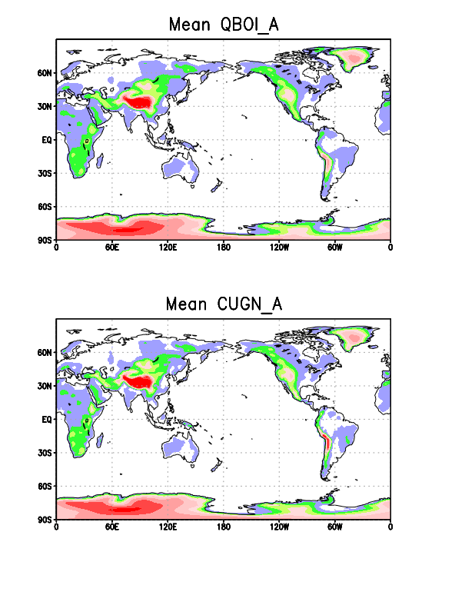
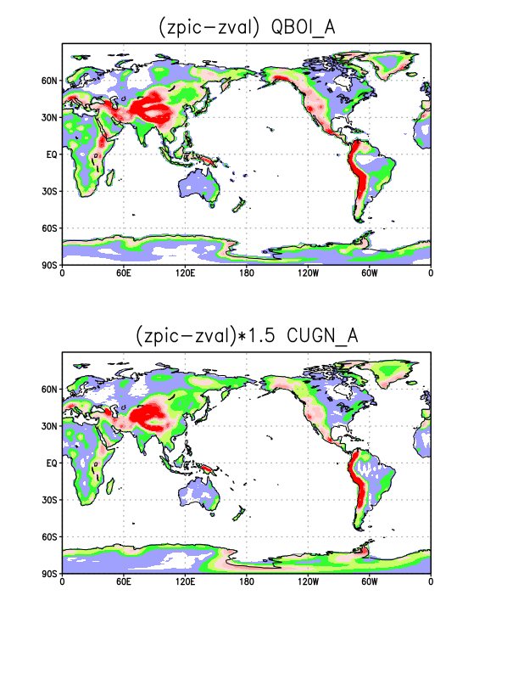
SSO Parameters:
Mean is good
Our evaluation of zpic & zval from
std. dev, underestimate the
difference by 50 %

Slide 3
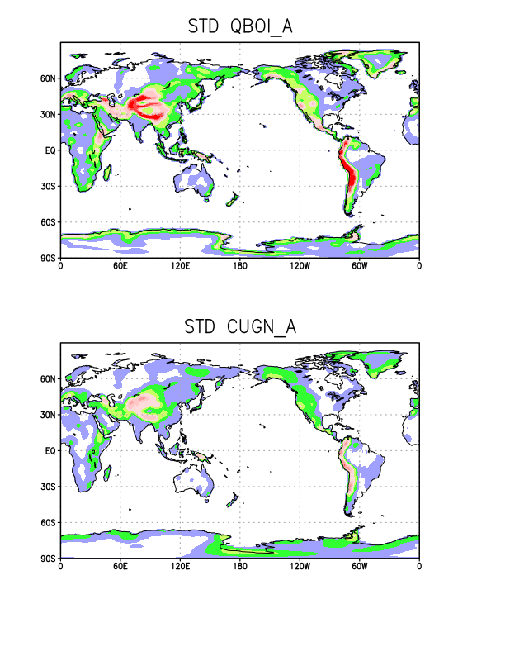
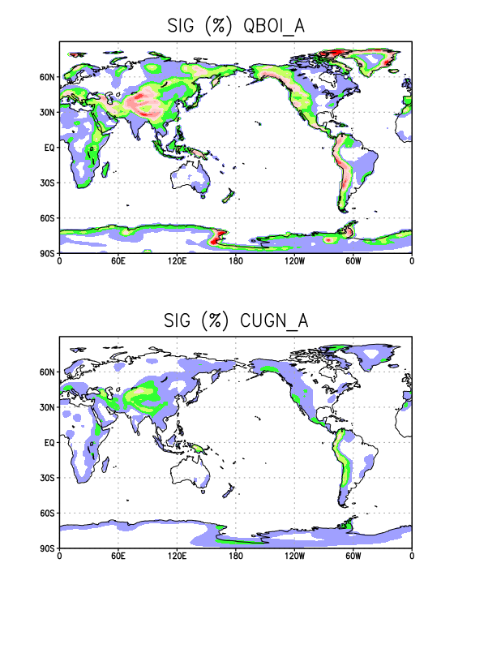
SSO Parameters:
Std devs and slope are underestimated again, note how large values in the
polar regions have been smoothed out by the telescope technique...
Mean is good

Slide 4
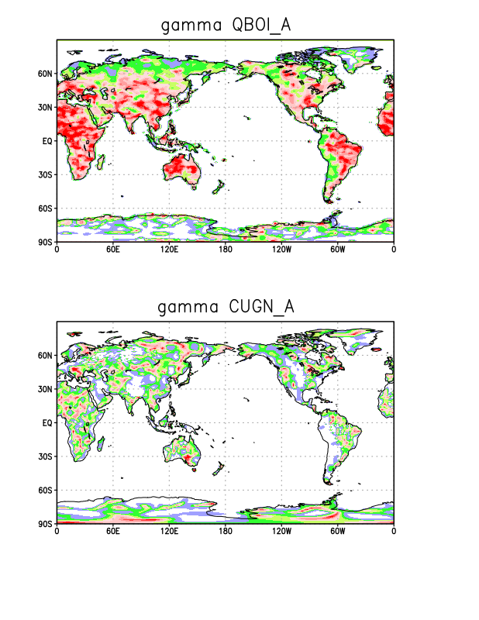
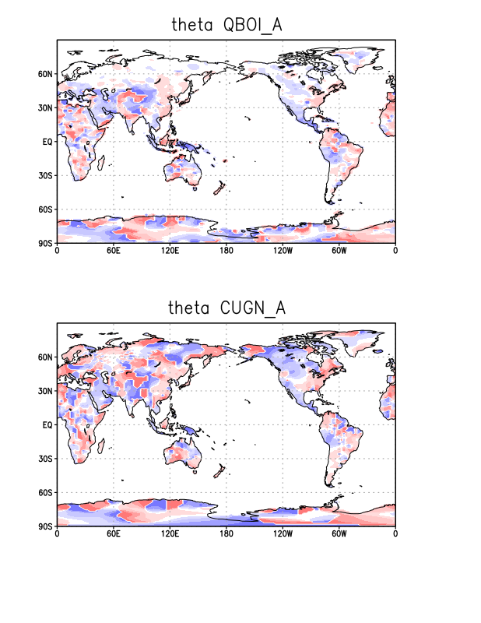
SSO Parameters:
Gamma (no comments) and Theta ;

Slide 5
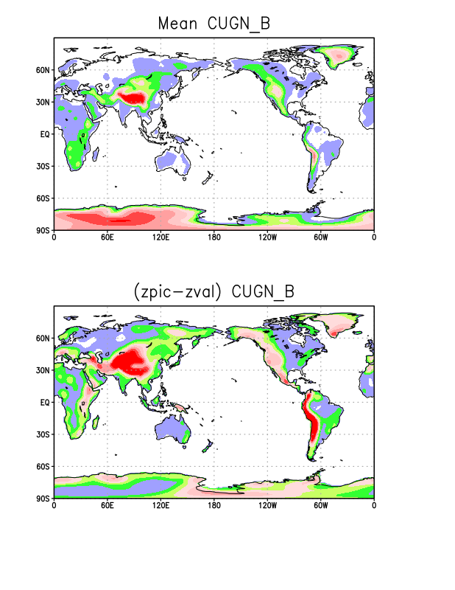
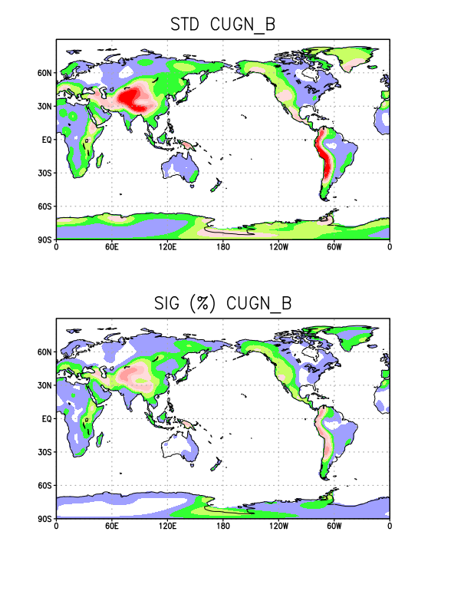
SSO Parameters, CUGN_B:

Slide 6
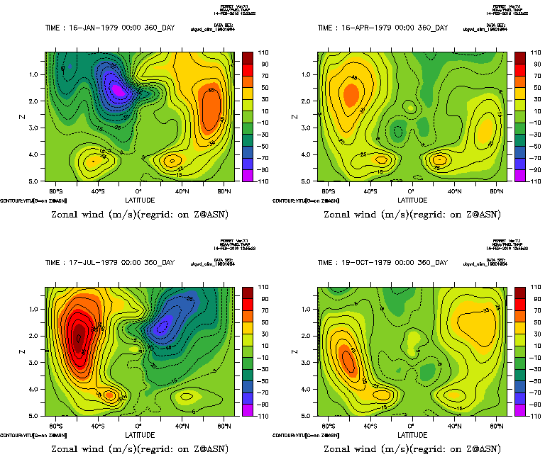
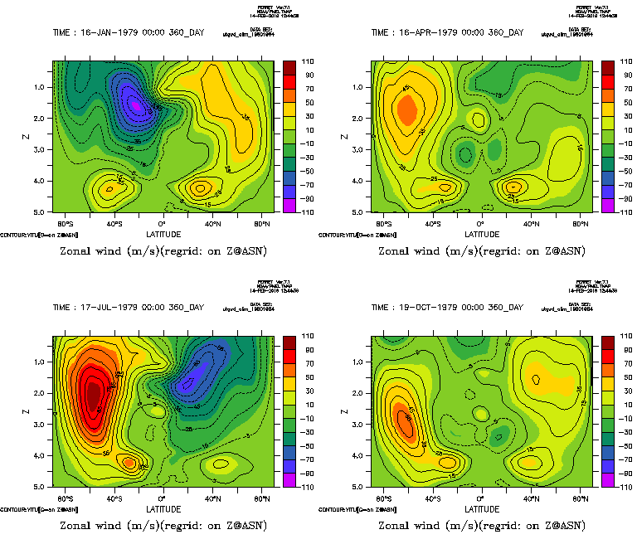
Zonal mean zonal winds
CUGN_A
QBOI_A

Slide 7
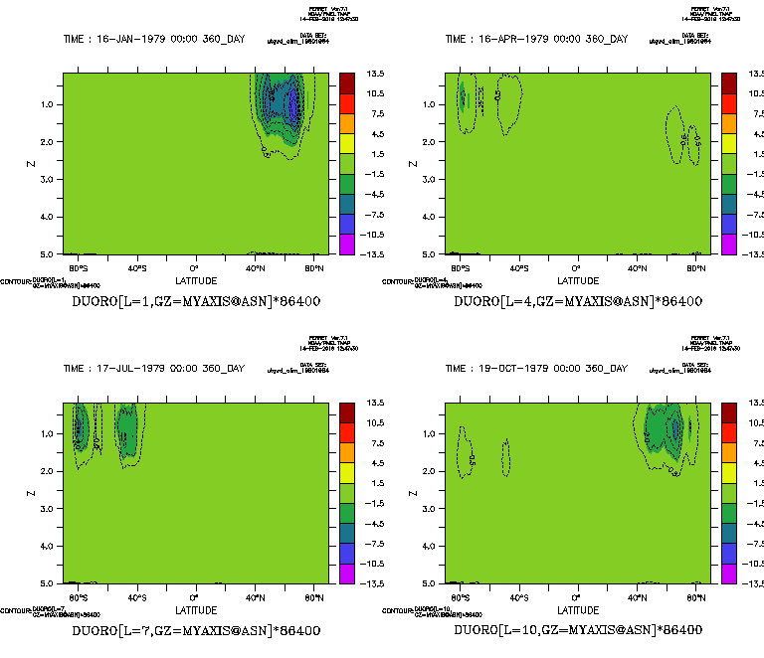
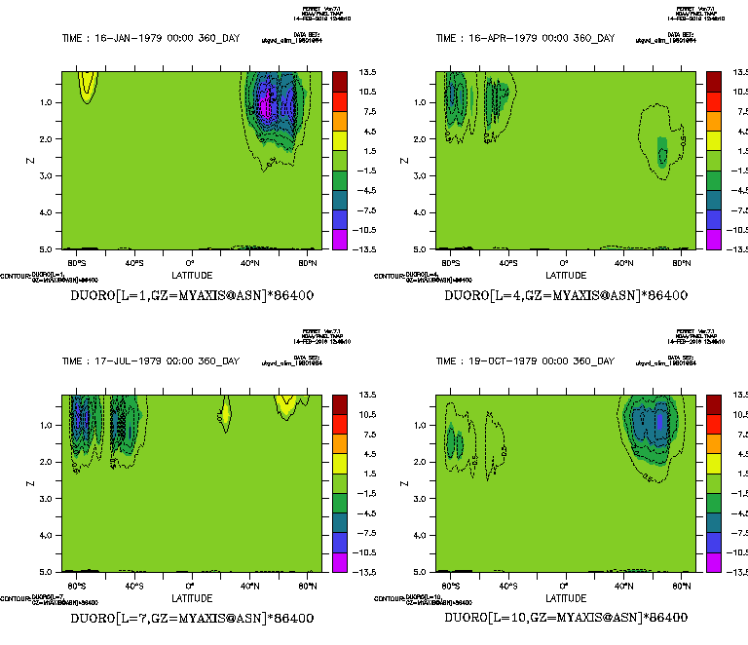
Zonal mean SSO zonal drag
CUGN_A
QBOI_A

Slide 8
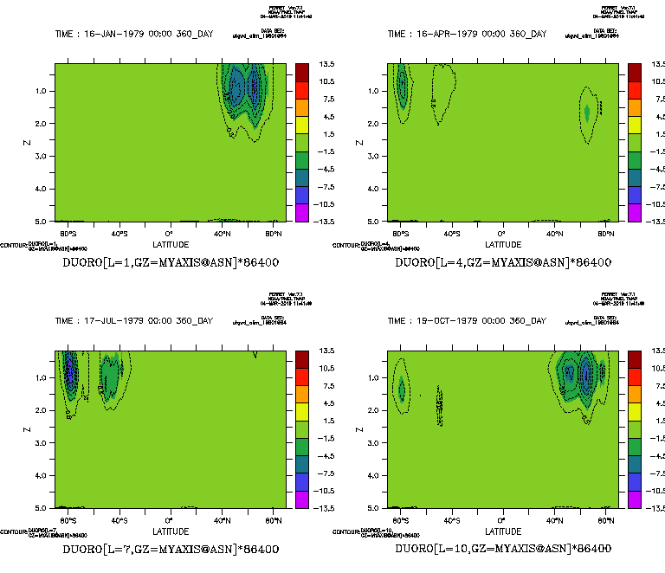
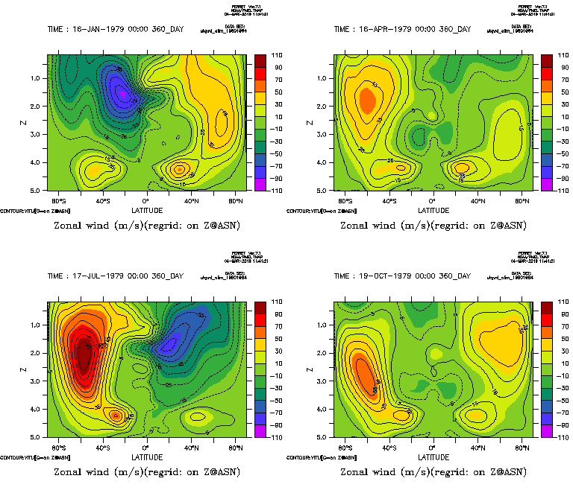
Zonal mean wind and SSO zonal drag, CUGN_b
CUGN_B
CUGN_B

Slide 9
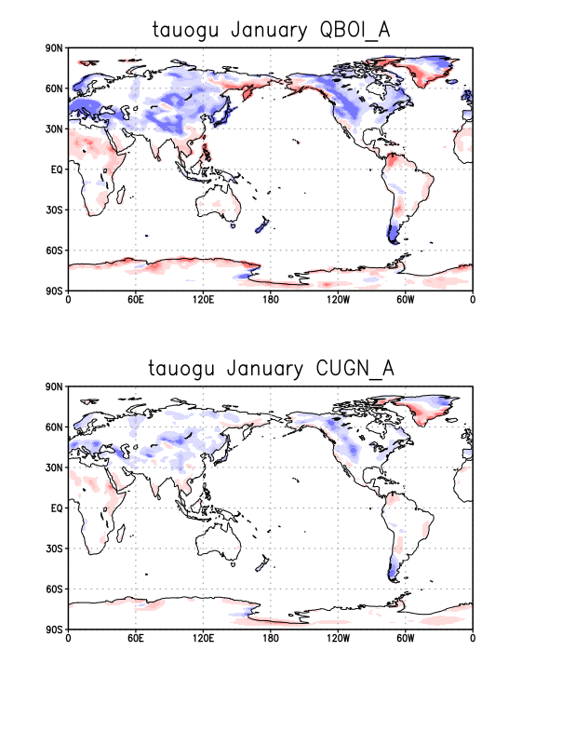
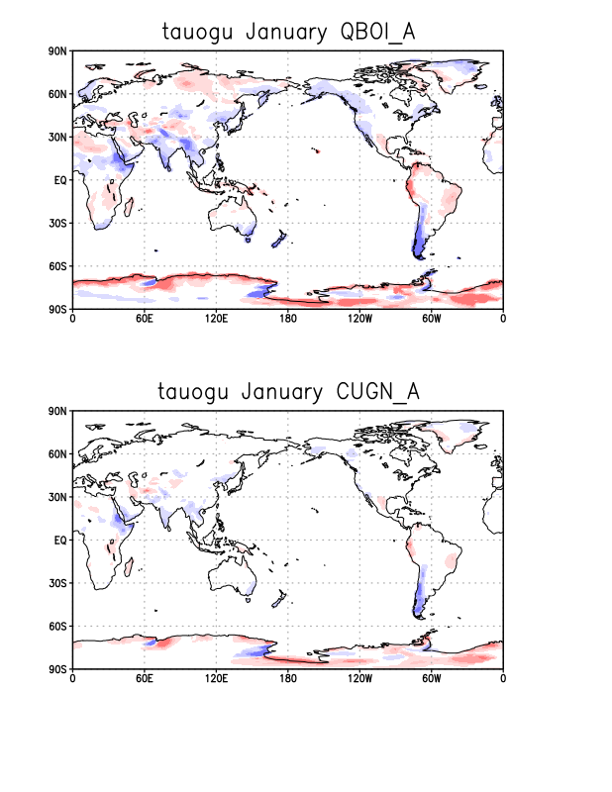
Surface zonal stress
January
July

Slide 10
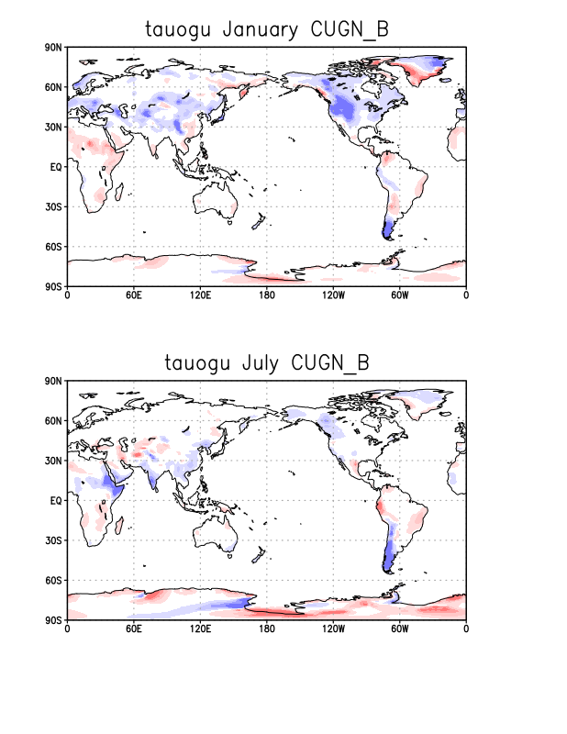
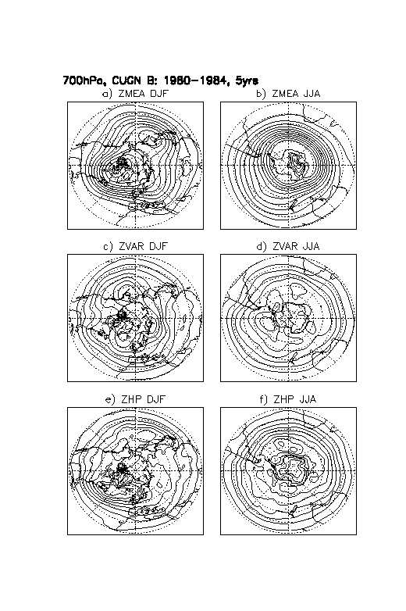
Surface zonal stress and planetary wave, 4° dataset

Slide 11
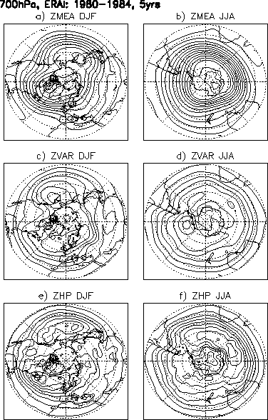
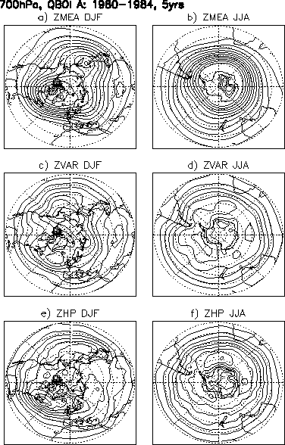
700hPa diagnostics, NH and SH Winters (DJF and JJA)
1980-1984 Period
ERAI
LMDz, CMIP6
LMDz, CUGN_A
Mean
Std Dev
Hi Pass
Std Dev

Slide 12
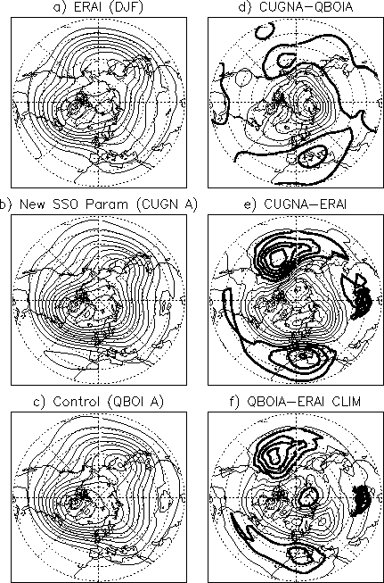
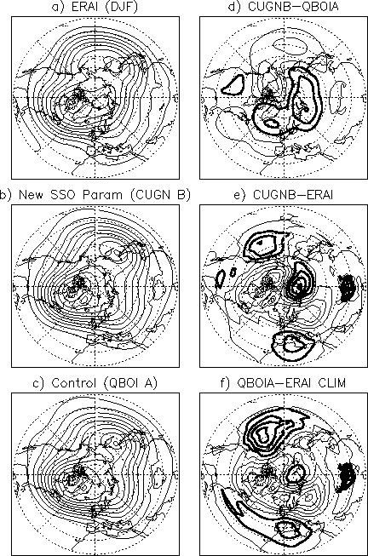
Steady planetary wave :
To type of SSO parameters

